Slide 1

Global Terrorism Analysis
PowerBI Project
BY ELMA FORTUNATE PHIRI
©FortunateCreations

Slide 2
Introduction
Analysis of Global Terrorism Dataset (1986 - 2017)
Description:
The Terrorism Database contains information about terrorist attacks worldwide. It includes details such as the date, location, attack type, weapons used, number of casualties, and responsible groups. Your task is to create a Power BI dashboard that provides a comprehensive overview of global terrorism trends and patterns.
•Data Source:
Global Terrorism Database (GTD), maintained by the National Consortium for the Study of Terrorism and Responses to Terrorism (START).
©FortunateCreations

Slide 3
Objectives
Identify the most targeted facilities by terrorist groups.
Analyze trends over time and geographical distribution.
Understand the methods and impact of terrorist attacks.
Identifying the most deadly terrorist groups
Understand types of weapons mostly used by Terrorist groups
Identifying countries and regions prone to terrorist attacks
©FortunateCreations

Slide 4
Overview
Data Loading
Data Transformation
Time Series Analysis
Geospatial Analysis
Trend Analysis
Dashboard
Insights
Recommendation
Reference and Acknowledgements
©FortunateCreations

Slide 5
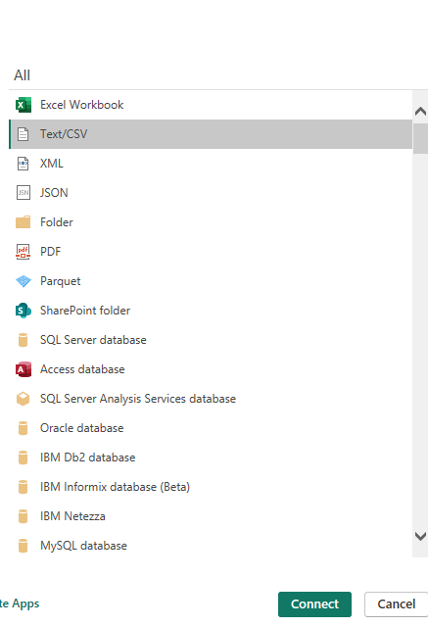
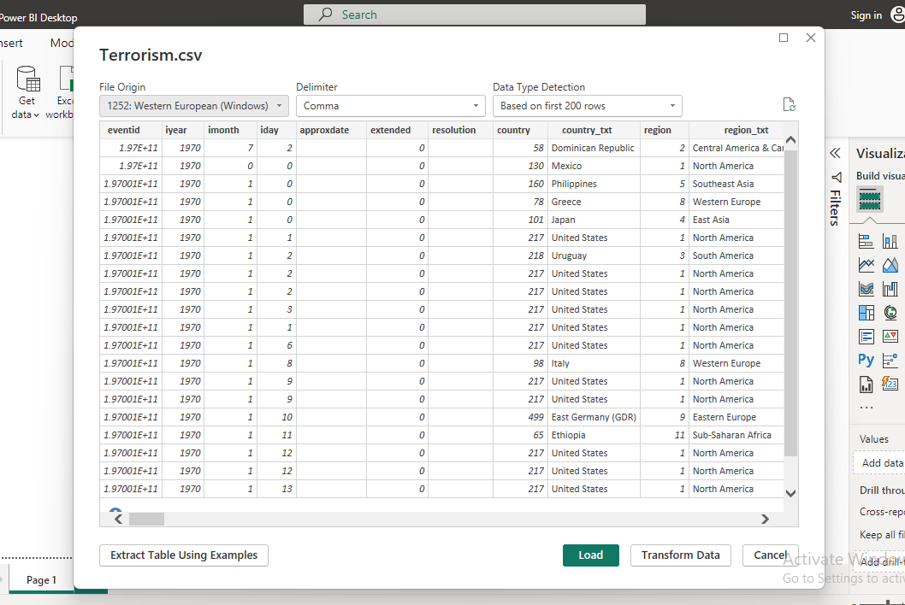
DATA LOADING
©FortunateCreations

Slide 6
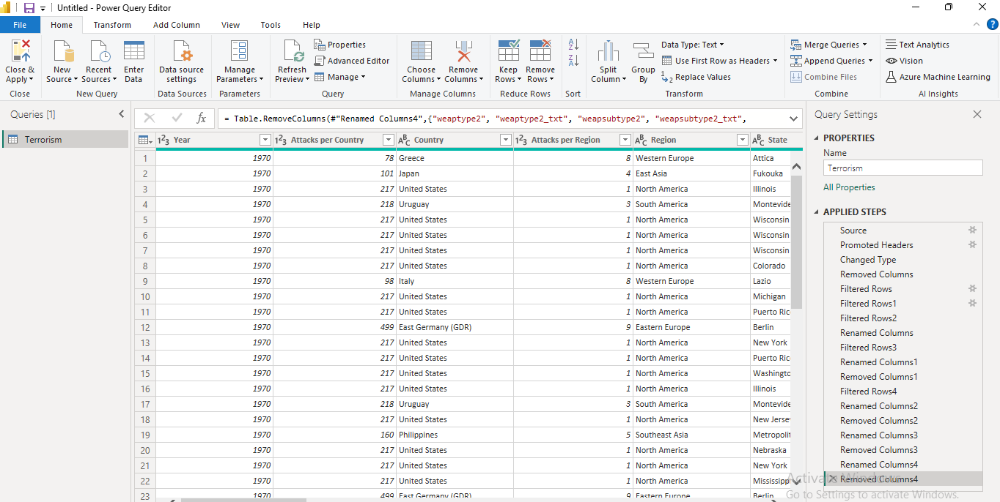
DATA TRANSFORMATING
Filtered Rows
Removed unnecessary Columns
Renamed Header Columns
©FortunateCreations

Slide 7
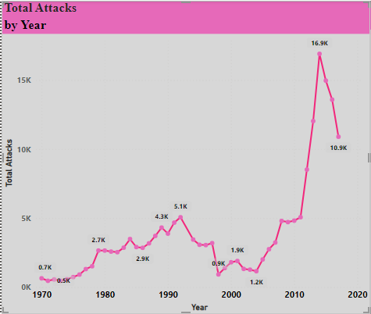
TIME SERIES ANALYSIS
Analyzed the number of terrorist attacks over time
Chart Type: Line Chart
Conclusion:
The highest number of attacks is 16903 in the year 2014
©FortunateCreations

Slide 8
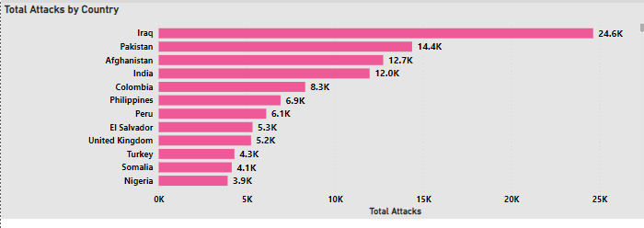
Analyzed the number of terrorist attacks per Country
Chart Type: Clustered Bar Chart
Conclusion:
Iraq has the most terrorist attacks – 24636
Pakistan has 14 368 terrorist attacks
©FortunateCreations

Slide 9
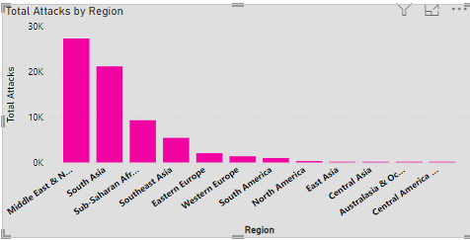
Analyzed the number of terrorist attacks by Region
Chart Type: Clustered Column Chart
Conclusion:
Middle East and North Africa has the most terrorist attacks – 27 430
South Asia has 21 264 terrorist attacks
©FortunateCreations

Slide 10
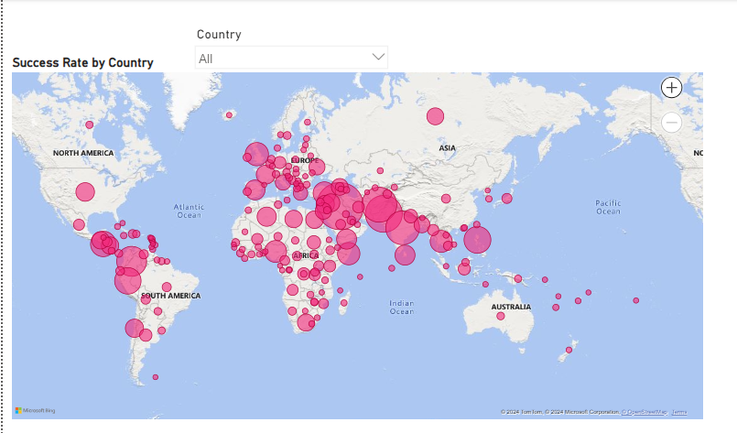
GEOSPATIAL ANALYSIS
Visualized successful attacks on a map
Chart Type: Map
Conclusion:
Most successful attacks are in Iraq, Afghanistan and India
©FortunateCreations

Slide 11
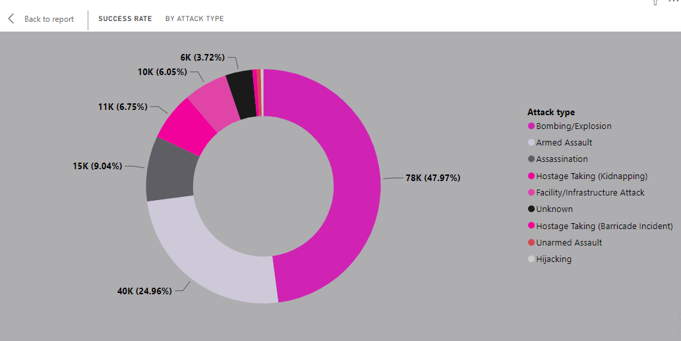
TREND ANALYSIS
Analyze attack types, weapon types and target type
Success Rate by Attack Type
Chart Type: Donut Chart
Conclusion:
The most successful attacks are done using Bombing/ Explosives - 47.97%
©FortunateCreations

Slide 12
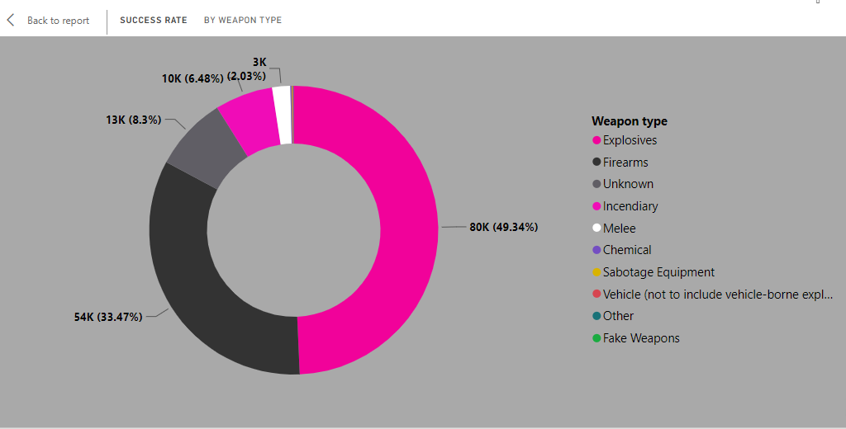
TREND ANALYSIS
Analyze attack types, weapon types and target type
Success Rate by Weapon Type
Chart Type: Donut Chart
Conclusion:
Explosives is the most commonly used weapon type in carrying out terrorism attacks with at percentage of 49.34%
©FortunateCreations

Slide 13
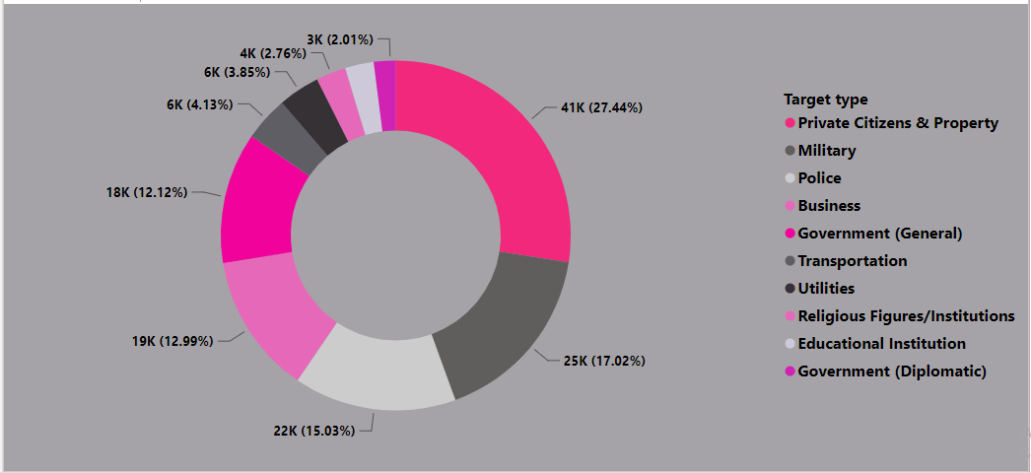
TREND ANALYSIS
Analyze attack types, weapon types and target type
Success Rate by Target Type
Chart Type: Donut Chart
Conclusion:
Private Citizens and Property is the most targeted group at 27.44% followed by the Military at 17.02%
©FortunateCreations

Slide 14
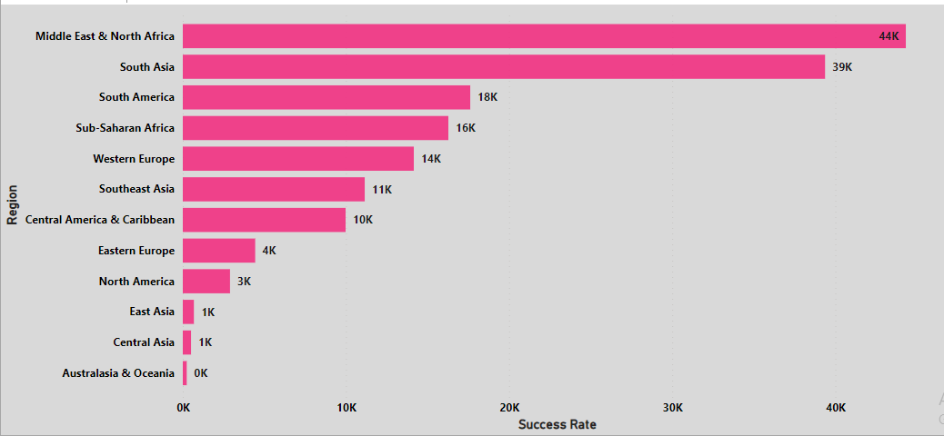
TREND ANALYSIS
Success Rate by Region
Chart Type: Clustered Bar Chart
Conclusion:
Terrorist Attacks are more successful in the Middle East & North Africa and South Asia
©FortunateCreations

Slide 15
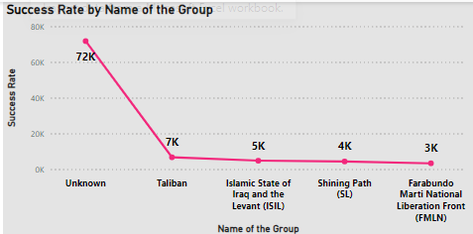
TREND ANALYSIS
Success Rate by Group Name
Chart Type: Line Chart
Conclusion:
The most successful terrorist group is the Unknown with 71 748 successful attacks followed by the Taliban with 6680 successful attacks
©FortunateCreations

Slide 16
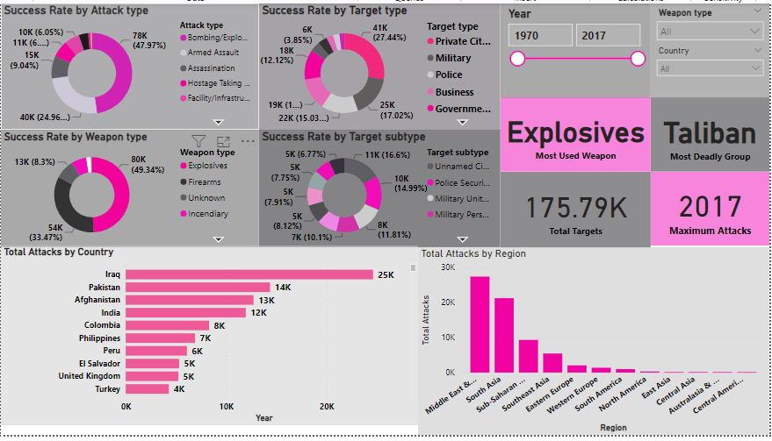
GLOBAL TERRORISM DASHBOARD
©FortunateCreations

Slide 17
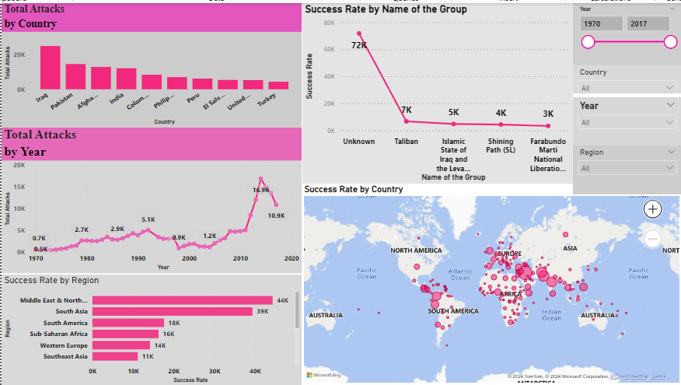
GLOBAL TERRORISM DASHBOARD
@FortunateCreations

Slide 18
Summary and Key Insights
Analyzing Global Terrorism data from 1986 to 2017 reveals the following key insights:
Most affected Countries are Iraq, Pakistan, Afghanistan and Colombia
The most affected regions are Middle East & North Africa, South Asia and South America
The highest number of attacks is 16903occurred in the year 2014
The most successful terrorist group is Unknown the followed by the Taliban Private Citizens and Property are the most targeted group at 27.44%
Explosives are the most commonly used weapon type in carrying out terrorism attacks with at percentage of 49.34%
The maximum number of attacked occurred in 2017
©FortunateCreations

Slide 19
RECOMMENDATIONS
•Actionable Recommendations:
Enhance security at high-risk facilities.
Increase international cooperation in intelligence sharing to combat terrorist attacks.
Invest in community resilience programs to mitigate impacts of terrorism.
•Future Research:
Deeper analysis of socio-economic factors influencing terrorism.
Study the effectiveness of counter-terrorism measures over time.
©FortunateCreations

Slide 20
REFERENCE AND ACKNOWLEDGEMENTS
•References:
Global Terrorism Database (GTD)
National Consortium for the Study of Terrorism and Responses to Terrorism (START)
•Acknowledgements:
Many thanks to mentors, colleagues, and data providers.
©FortunateCreations

